Slide 1


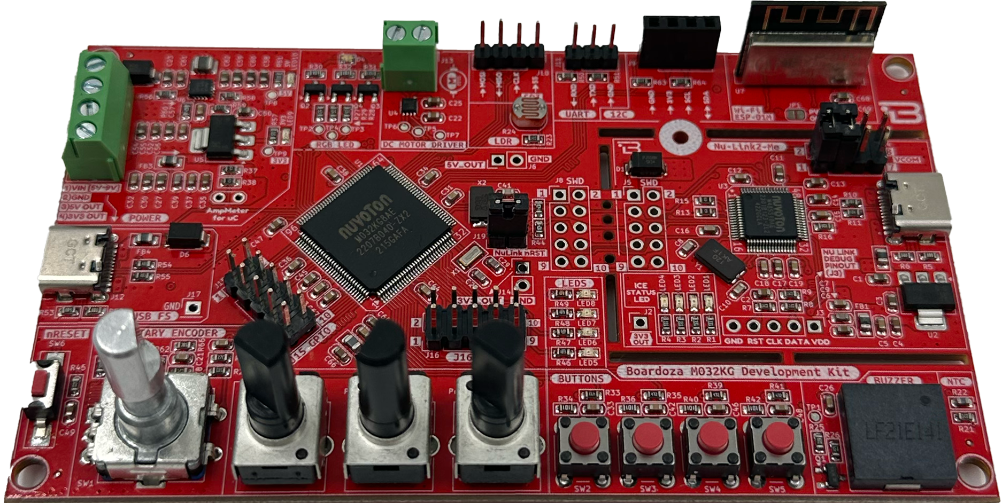
NuMicro® MCU MikroDenetleyici Eğitimi
BORDOZA M032KG
Development Board
Çeviren ve Anlatan: Doç. Dr. Barış GÖKÇE
Ocak 2025
BORDOZA M032KG
Development Board
Not: Bu doküman’ın telif hakkı tamamen Bordoza ve Özdisan firmasına aittir.
https://github.com/brgokce/NUVOTON-M032KG

Slide 2
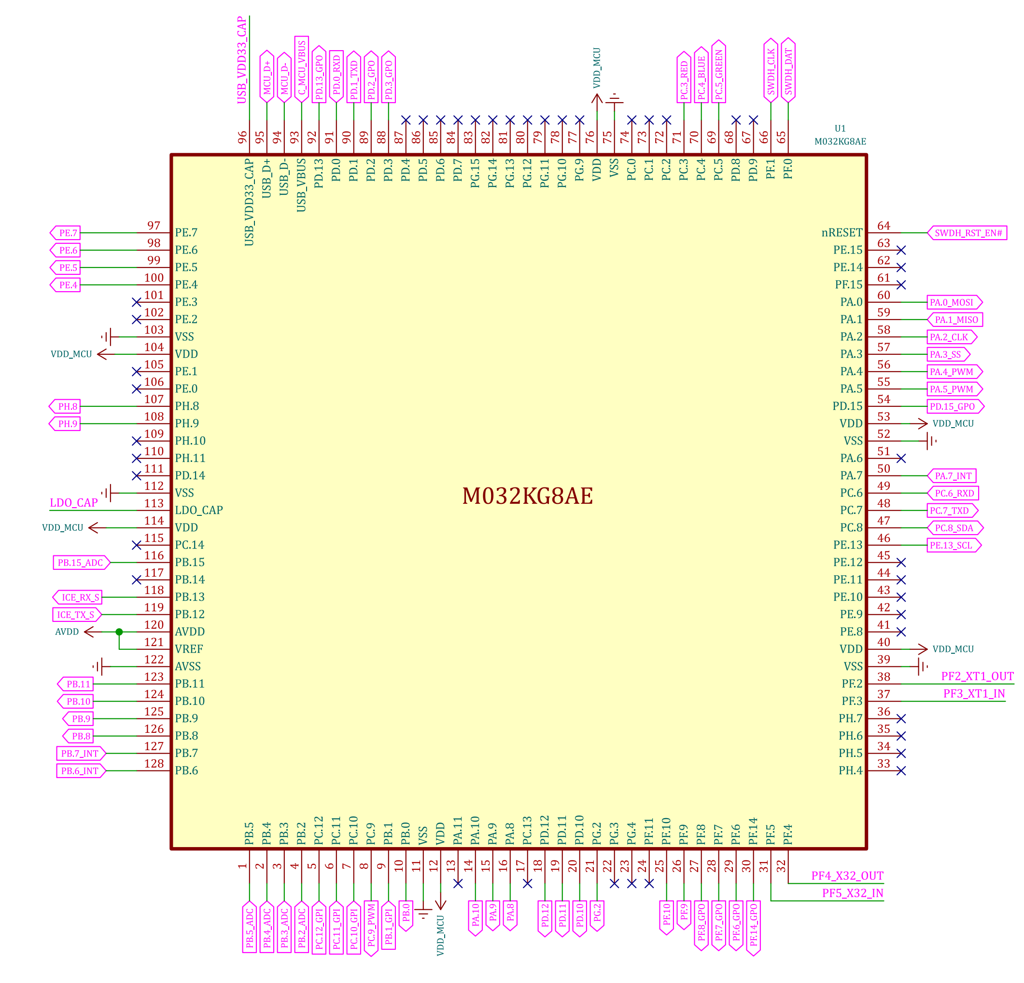
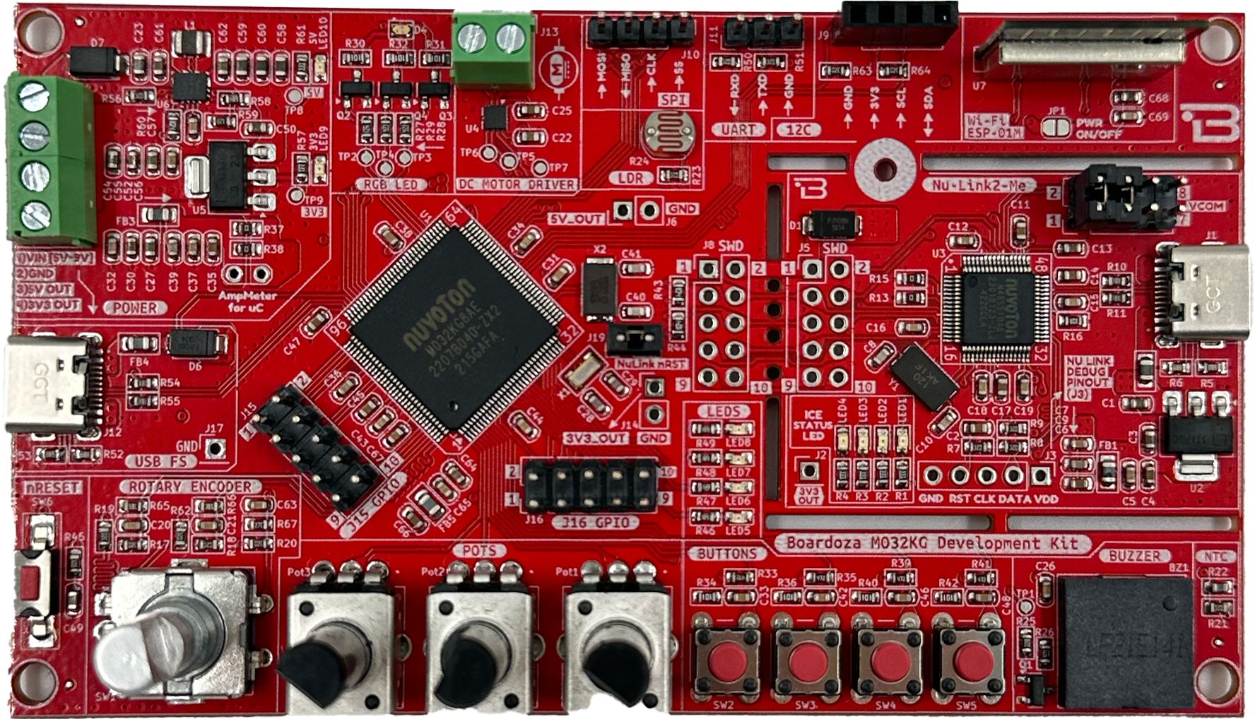

Slide 3
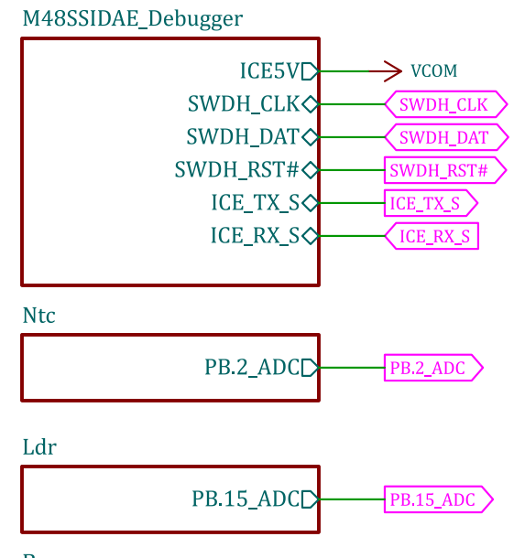
NuLink Debugger
https://github.com/brgokce/NUVOTON-M032KG

Slide 4
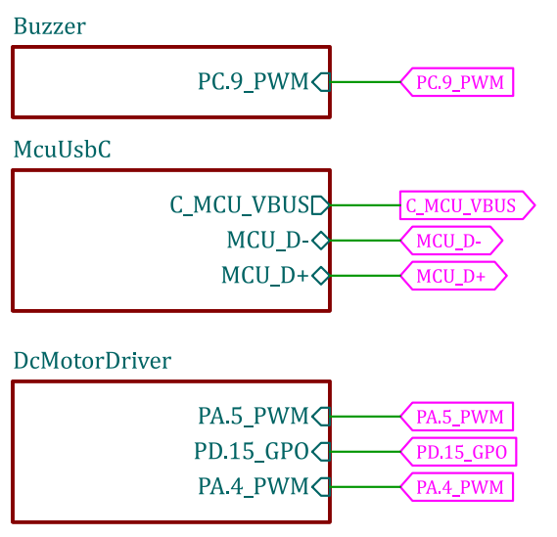
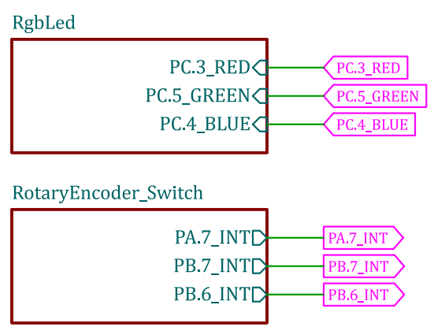
Temel Bileşenler ve Giriş / Çıkışlar

Slide 5
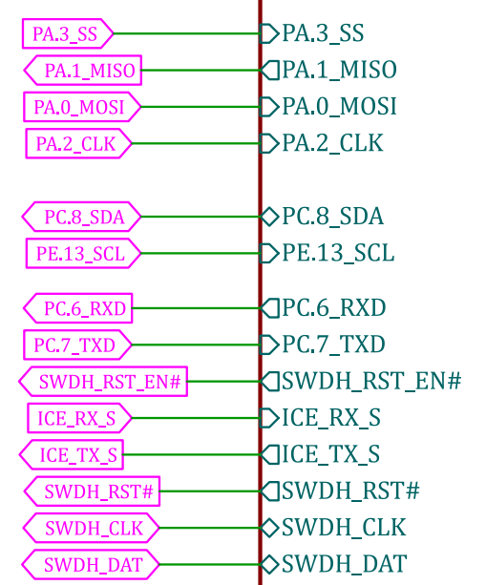
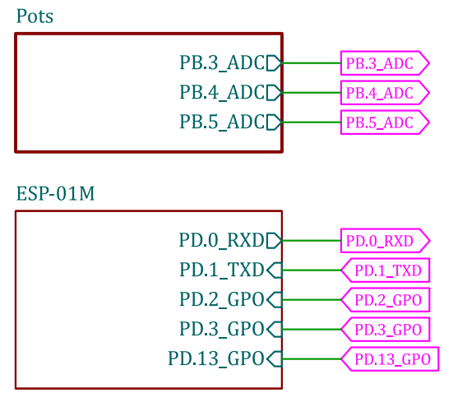
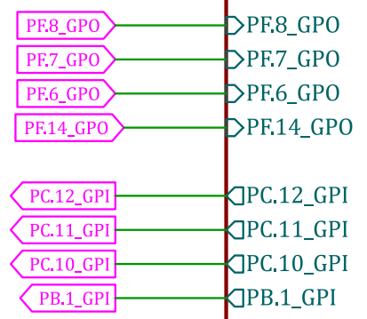
Temel Bileşenler ve Giriş/Çıkışlar

Slide 6
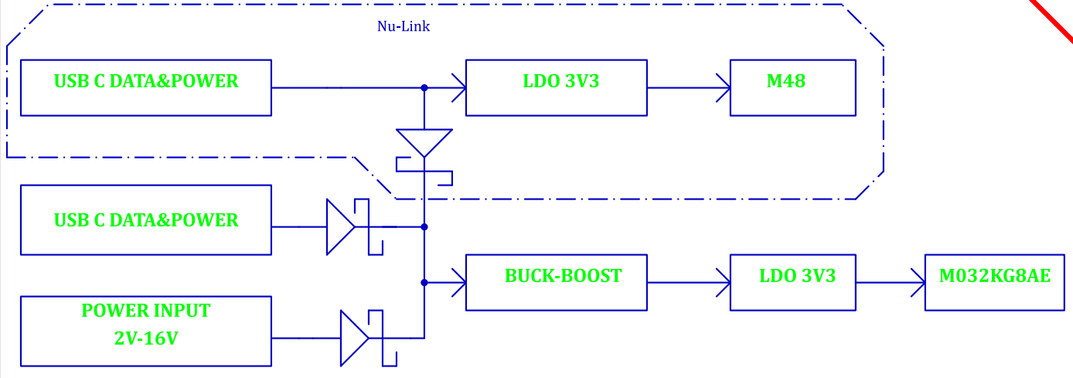
Güç Dağıtımı
https://github.com/brgokce/NUVOTON-M032KG

Slide 7
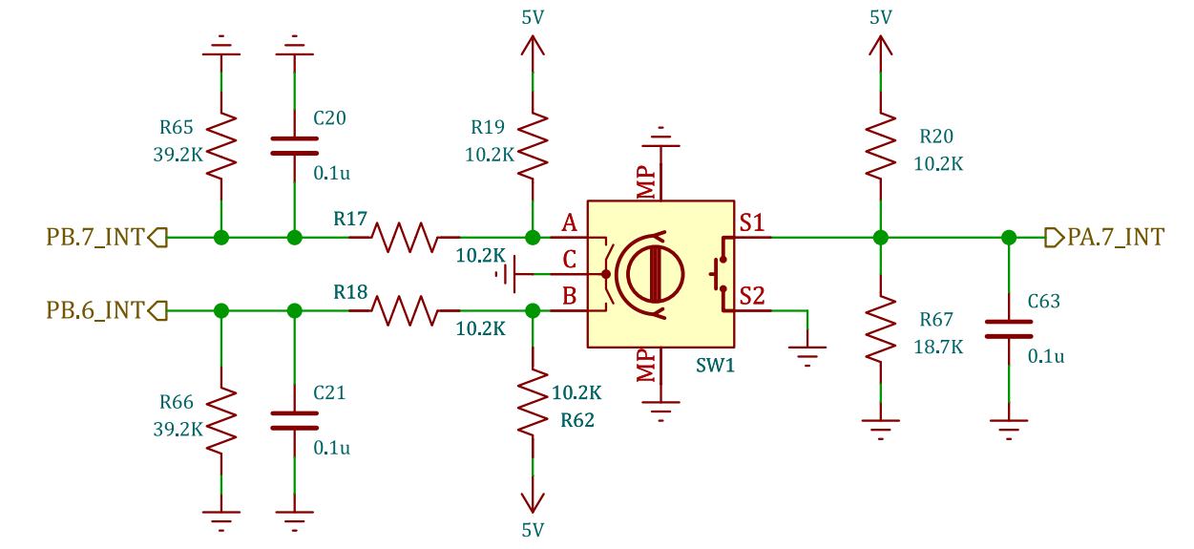
Rotary Encoder Switch
https://github.com/brgokce/NUVOTON-M032KG

Slide 8
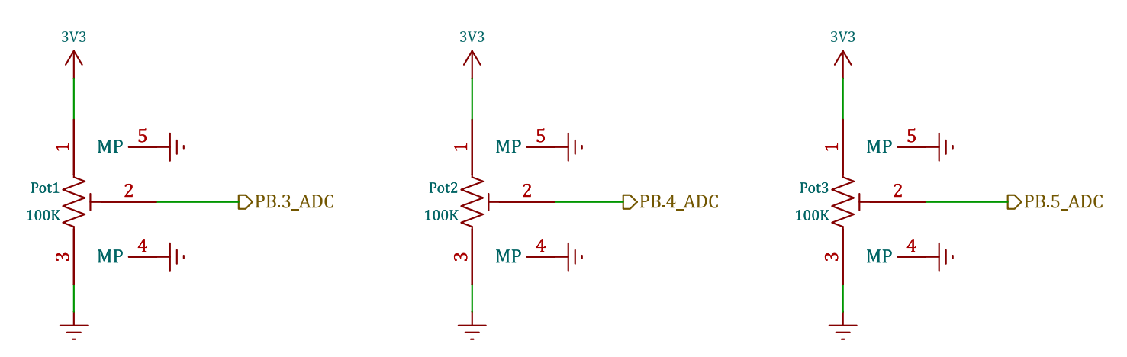
POTS
https://github.com/brgokce/NUVOTON-M032KG

Slide 9
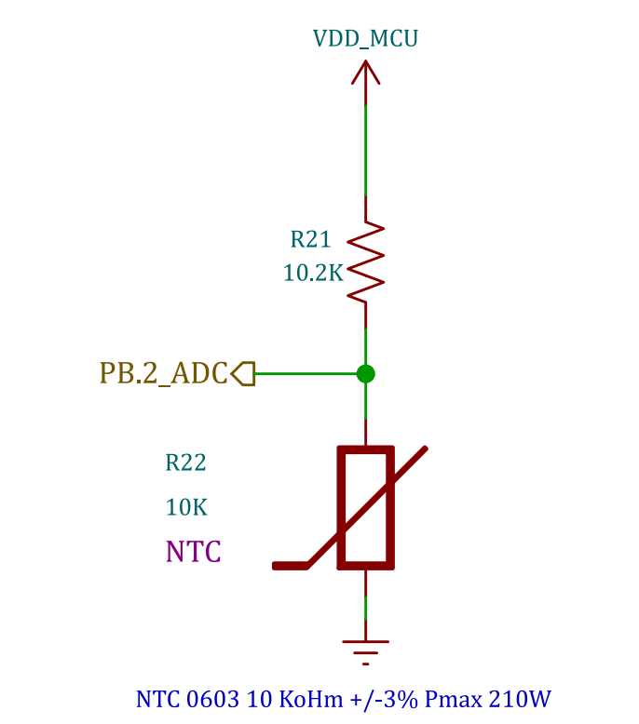
NTC
https://github.com/brgokce/NUVOTON-M032KG

Slide 10
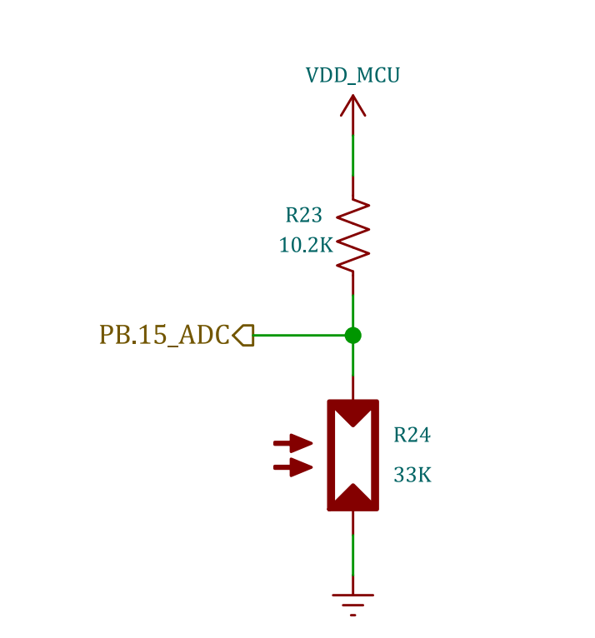
LDR
https://github.com/brgokce/NUVOTON-M032KG

Slide 11
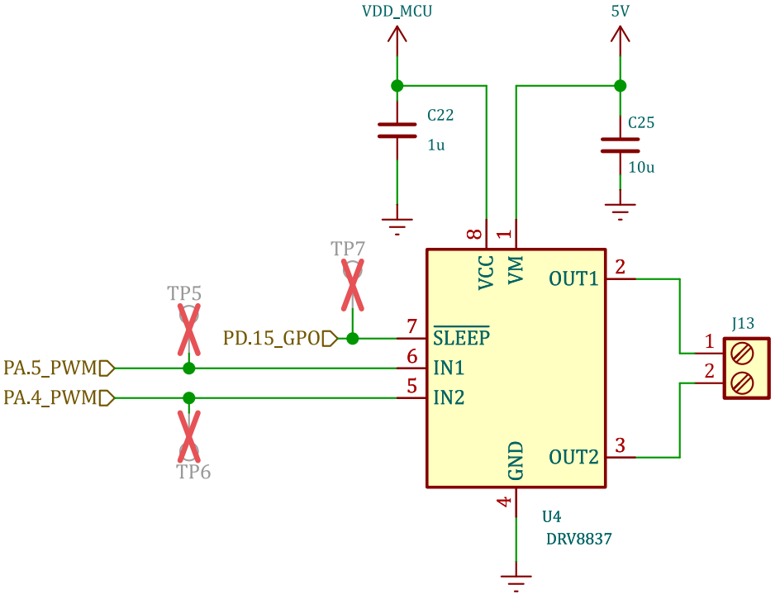
Motor Driver
https://github.com/brgokce/NUVOTON-M032KG

Slide 12
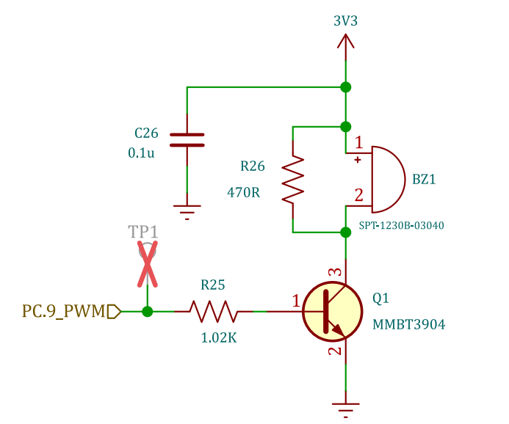
Buzzer
https://github.com/brgokce/NUVOTON-M032KG

Slide 13
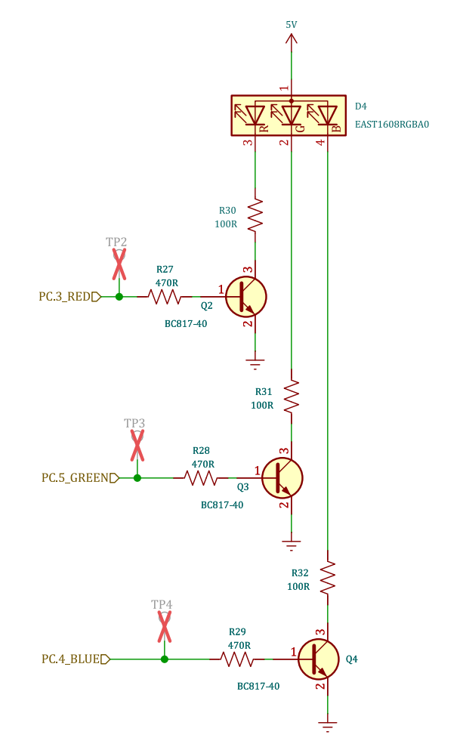
RGB LED
https://github.com/brgokce/NUVOTON-M032KG

Slide 14
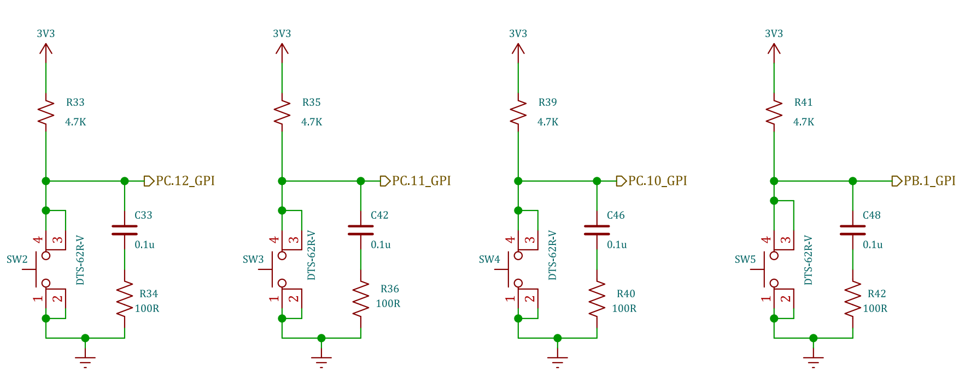
User Buttons
https://github.com/brgokce/NUVOTON-M032KG

Slide 15
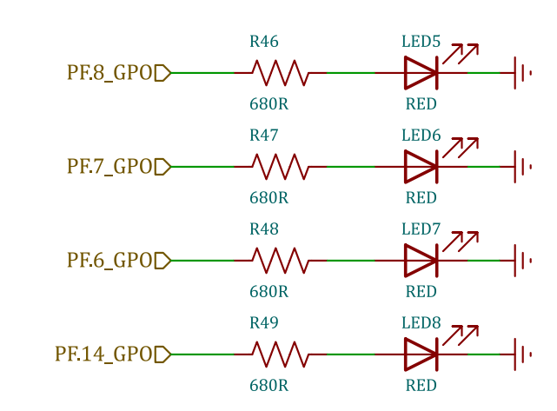
LEDS
https://github.com/brgokce/NUVOTON-M032KG

Slide 16
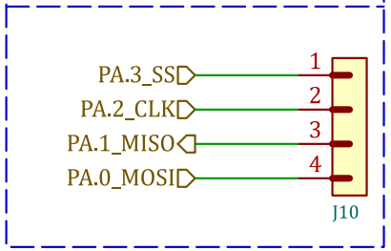
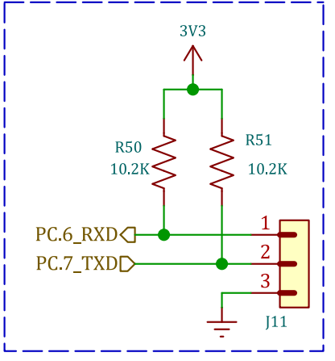
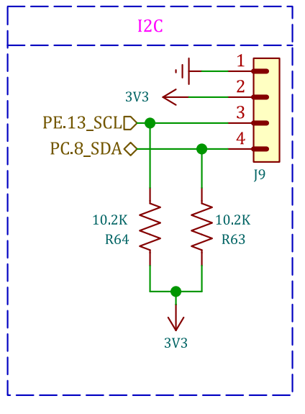
UART, I2C, SPI
https://github.com/brgokce/NUVOTON-M032KG

Slide 17
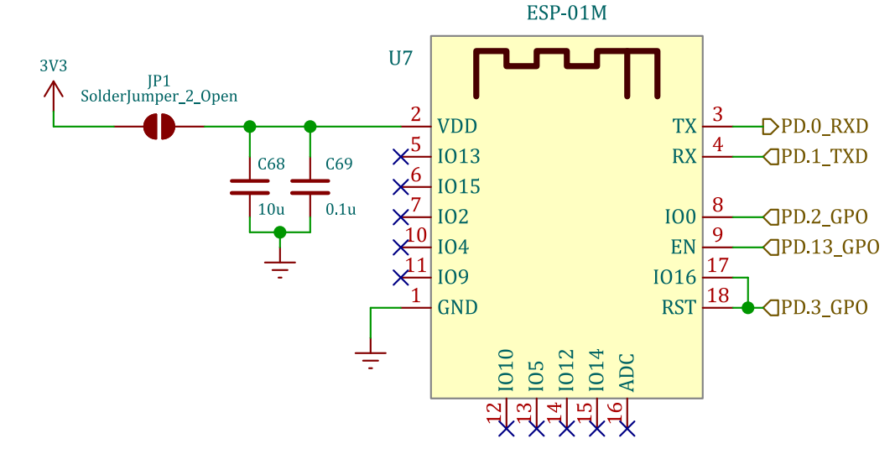
ESP01-M
https://github.com/brgokce/NUVOTON-M032KG

Slide 18
Teşekkürler
Dr. Barış gökçe
https://github.com/brgokce/NUVOTON-M032KG

